Slide 1


Hospitality: Marketing Measurement
Challenges
Solutions
Client wanted to revamp its marketing measurement methodology by combining top down and bottoms up approaches, given new business realities during post-Covid period.
The existing optimization approach was channel-focused, and client goal was to enhance approach by incorporating customer-focus as well.
In particular, the Client wanted to base media spend decisions on long-term customer value by segment in addition to cost per conversion.
Limited in-market testing had been conducted prior, and there was an opportunity to optimize the mix using a robust testing framework.
Assessed current measurement tools and reports & performed stakeholder interviews with key stakeholders.
Analyzed existing measures, data sources and attribution solutions.
Created custom identify graph to build individual level journeys
Performed digital journey analysis using Markov Chain on user level data.
Developed Multi-Touch Attribution Pilot.
Developed a comprehensive roadmap for building unified measurement capabilities by combining top-down and bottom-up approaches.
Exploratory Analysis –
Data and Measures
Global Brand Unified Measurement Framework & Roadmap For Best-in-class Capabilities
Digital Journey Analysis - Methodology
Marketing/Measurement Assessment
Roadmap and Quick Hits
Impacts
Recommended Initiatives – Roadmap Overview
Core initiatives over the next 18 months to drive measurement evolution
Chief Analytics Officer adopted measurement roadmap and funded key priorities
Markov Chain analysis identified opportunities to adjust spend in key channels at top, mid and
lower funnel
Working with Marketing Measurement Team to operationalize high priority items
Immediate focus is Cross-Channel Reporting and
Multi-touch Attribution
New Solutions
1. Evolve MTA as Core Optimization tool
2. Reintroduce MMM for incrementality
3. Advance Customer/Audience Lens
4. Address Identity, data stitching and audience data issues
5. Develop and Activate Marketing Hierarchy Taxonomy
Foundations
6. Implement Cross-Channel Reporting
7. Establish Holistic Control Group Strategy and Process
8. Develop Measurement Governance to align with marketing teams
9. Implement Monthly Measurement Business Reviews and Scorecard
10. Develop integrated learning plan to inform testing

Slide 2




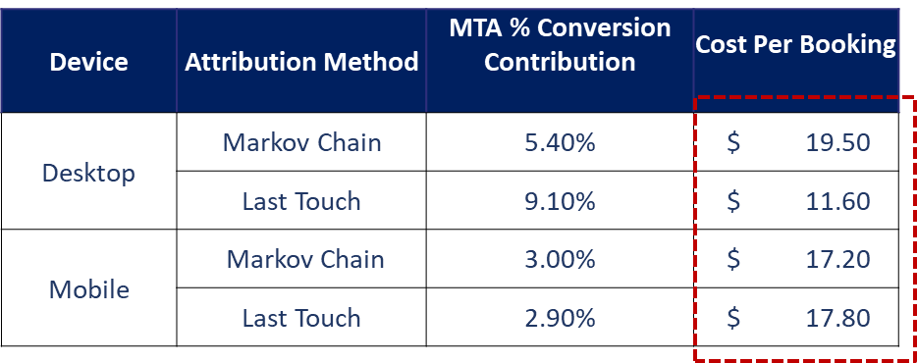
Hospitality: Marketing Measurement
Data Engineering
Optimal Look Back
Window Analysis
Optimal Look Back
Window Analysis
Click Data
Developed Multi-touch Attribution Solution Using Markov Chain Methodology
Impression Data
Member Data
Cost Data
Media Contribution Analysis
Digital Journey Insights
Scenario Analysis

